Slide 1
Things to do in Belgium

Slide 2
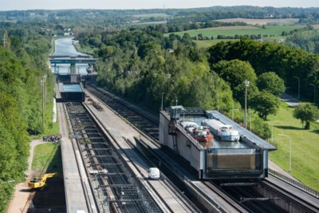
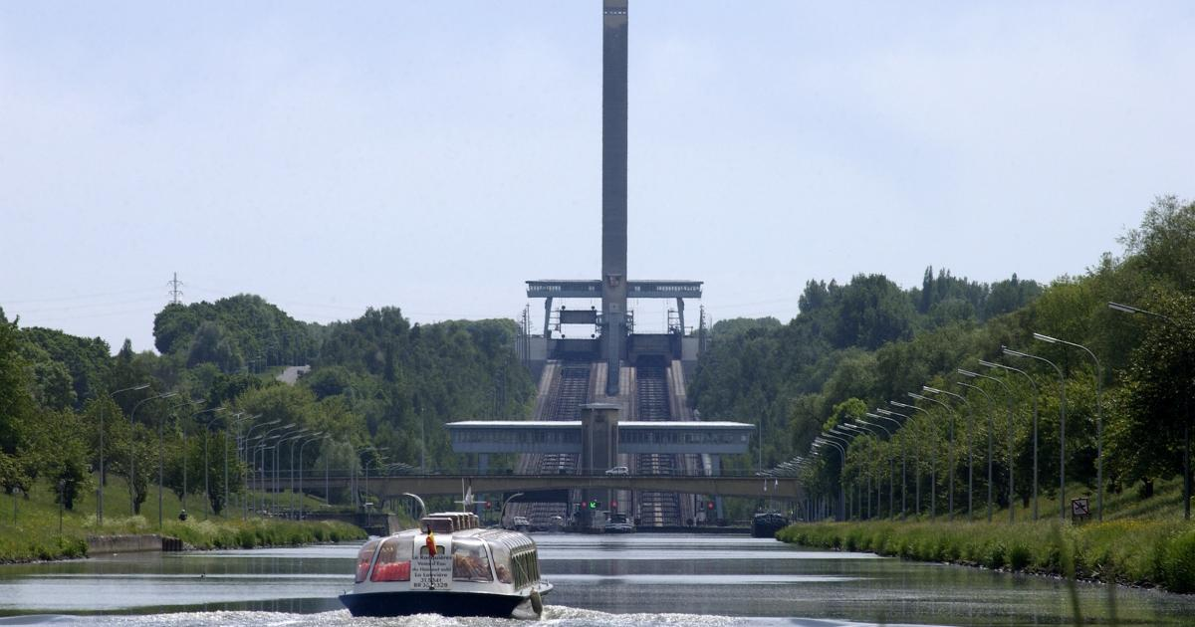
Discover the longest inclined plane in the world !
Launched in 1968, the Sloping Lock of Ronquières is one of the most outstanding technical achievements of the second half of the 20th century.
Still today considered to be the longest inclined plane in the world with its slope of 1432 metres, it allows inland waterway vessels to cross a difference in height of 68 metres on the Charleroi-Brussels canal.
The ship sails into a huge container (90 meters) that is then pulled up the slope by steel cables and an electromotor. It looks like it is going very slow but it only takes 20 minutes for the ship to go up or down. Before they needed to go through 16 locks which took them 2 days.
Unfortunately, the main ‘user’ of the system, the Walloon coal industry collapsed shortly after the system was introduced and for some decades the amount of traffic was much lower than expected. Nowadays, more and more ships are using the lock again.
https://www.canalducentre.be/en/visits/the-sloping-lock-of-ronquieres/

Slide 3
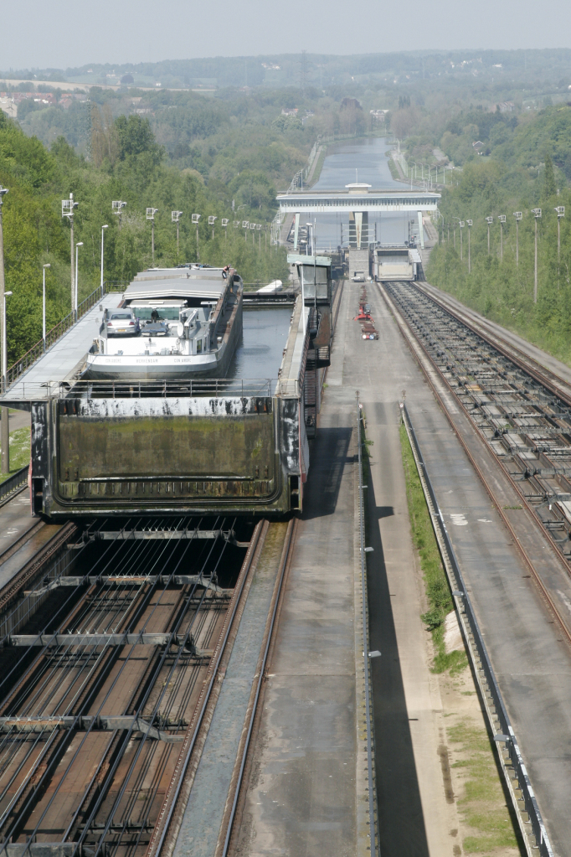
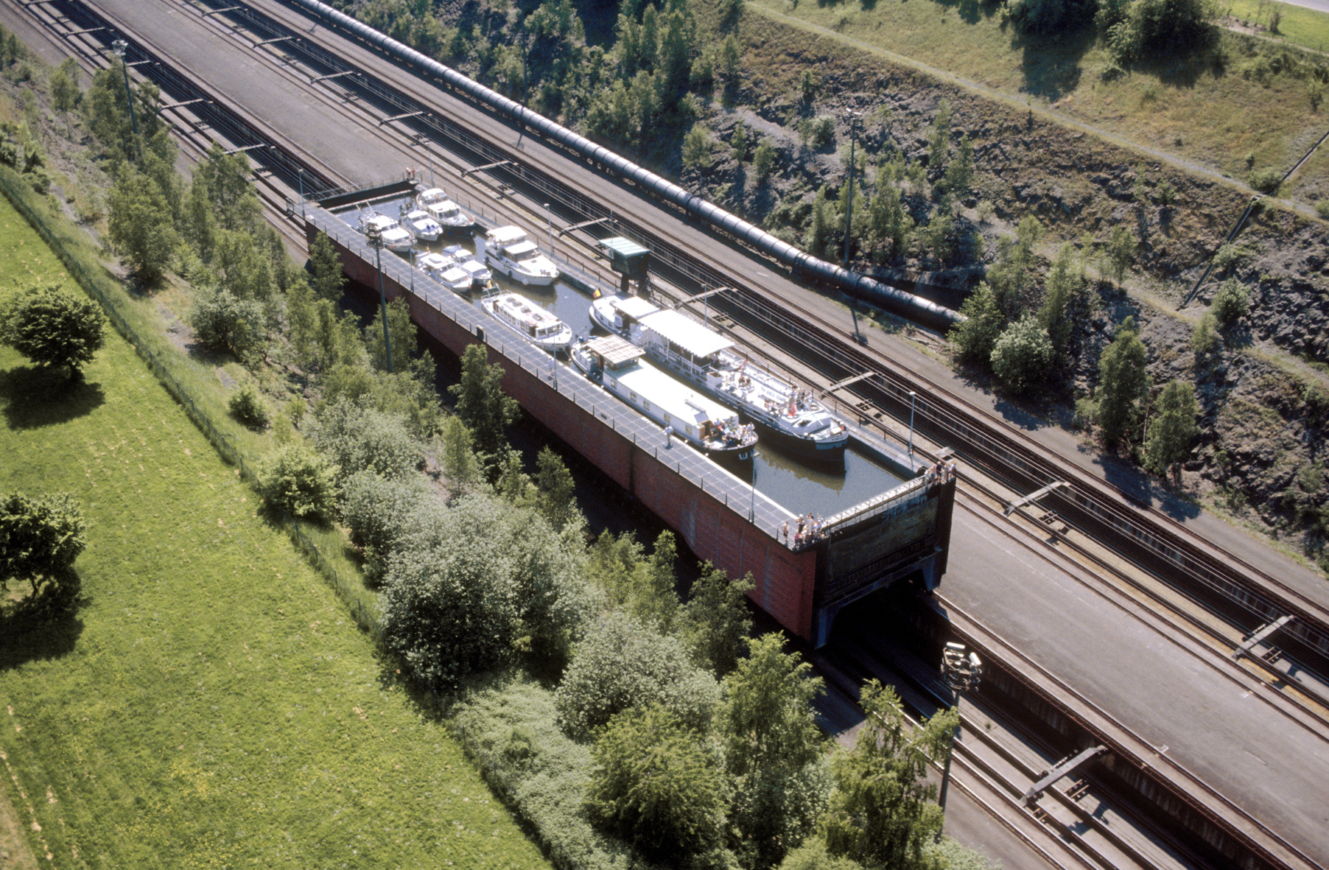
The Sloping Lock of Ronquières

Slide 4
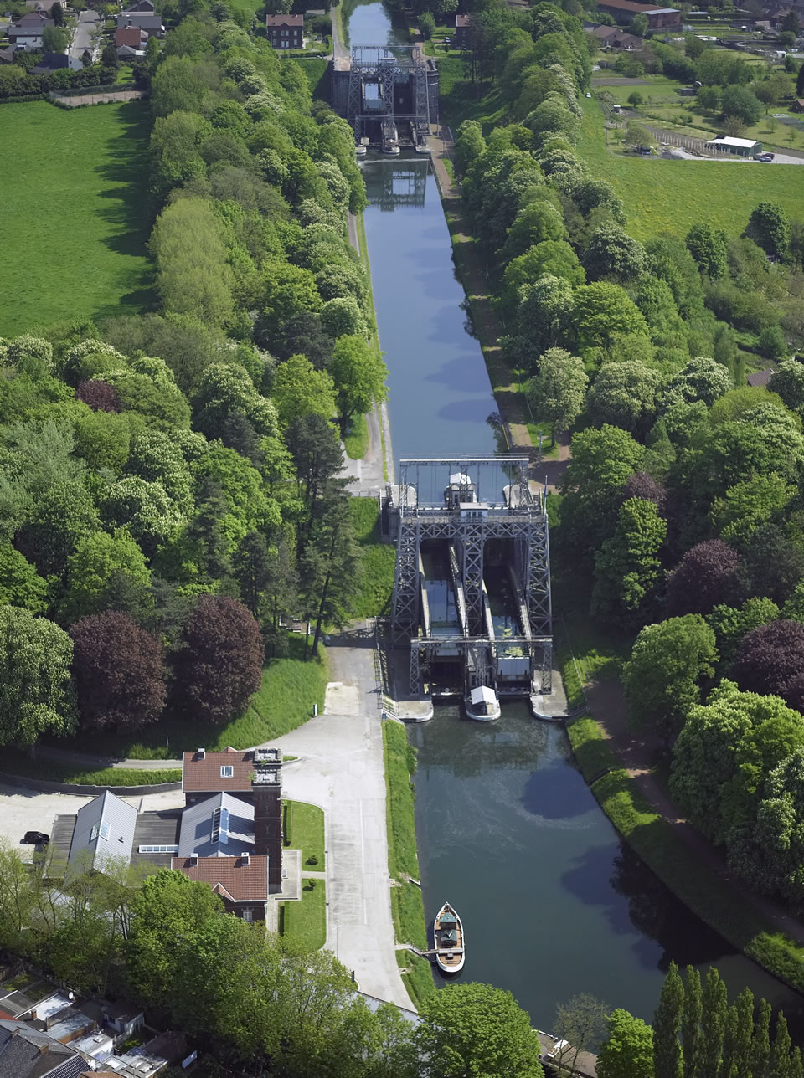
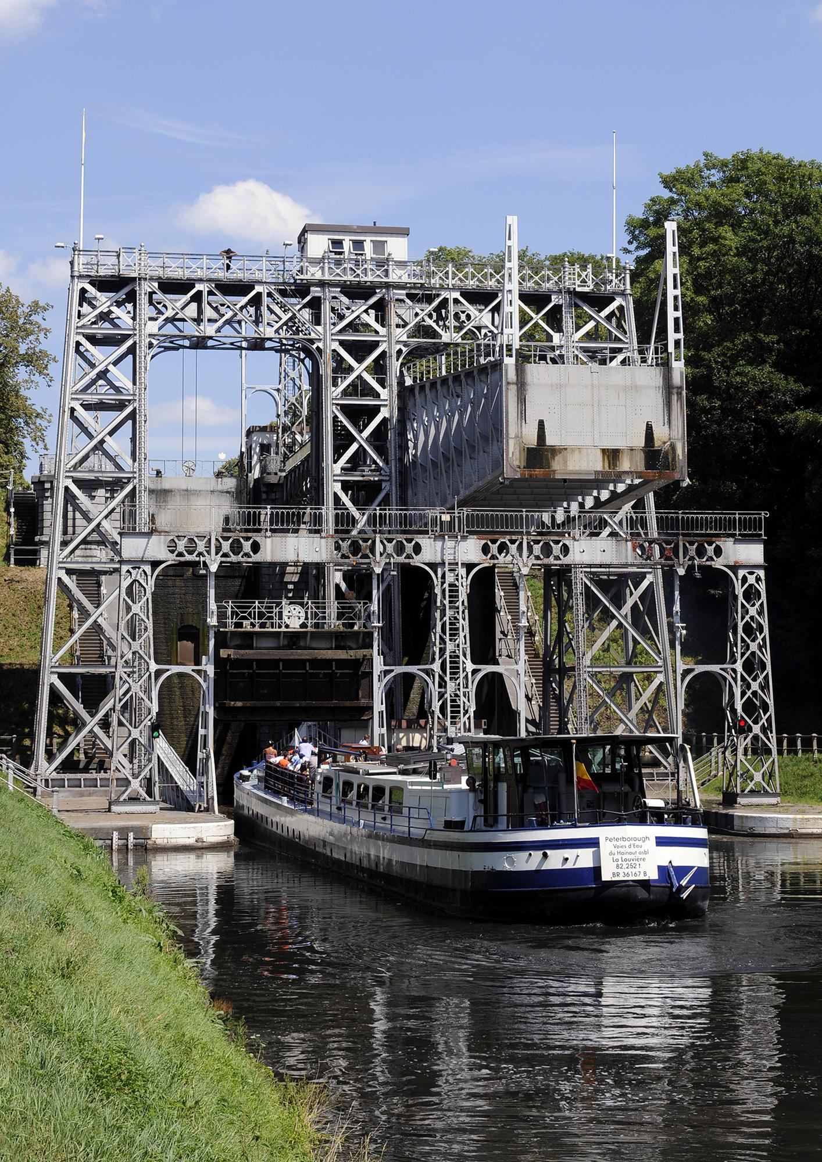
The Four Lifts on the Canal du Centre (province of Hainaut)
The Canal du centre is a canal that links the rivers Meuse and Schelde.
The Belgians wanted an inland waterway that connected the two rivers but the problem was the height difference between the two rivers (approx.96 meters).
That would require as many as 32 locks which was not feasible. So a plan was adopted to use boat lifts instead of locks.
The canal begins at the west of Mons and goes through the towns of Nimy, Obourg, Villes-sur-Haine and Thieu.
This section is 15 km and has a relief of 23.26 meters. It climbs by means of six locks.
The next section was the problem: the route between Thieu and Houdeng-Goegnoes climbs 66 meters over a distance of 6790 meter.
This section contains the boat lifts.
The first lift was built between 1885 and 1888. The three other lifts were finished in 1917 and inaugurated in 1919.

Slide 5
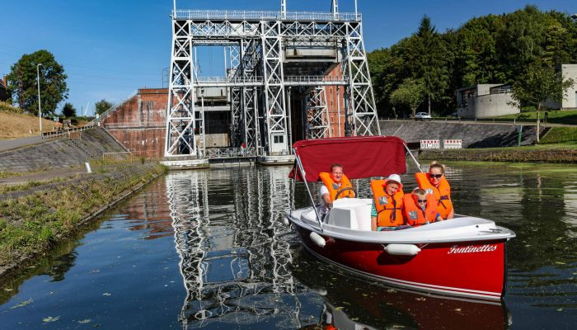
The four hydraulic boat-lifts on this short stretch of the historic Canal du Centre are industrial monuments of the highest quality.
They are remarkably well-preserved and a complete example of a late-19th-century industrial landscape.
Of the eight hydraulic boat-lifts built at the end of the 19th and beginning of the 20th century, the only ones in the world which still exist in their original working condition are these four lifts on the Canal du Centre. They are now on the UNESCO world heritage list
https://www.canalducentre.be/en/visits/the-historic-canal-centre/
http://voiesdeau.hainaut.be/fr/formule/location-bateaux-electriques/

Slide 6
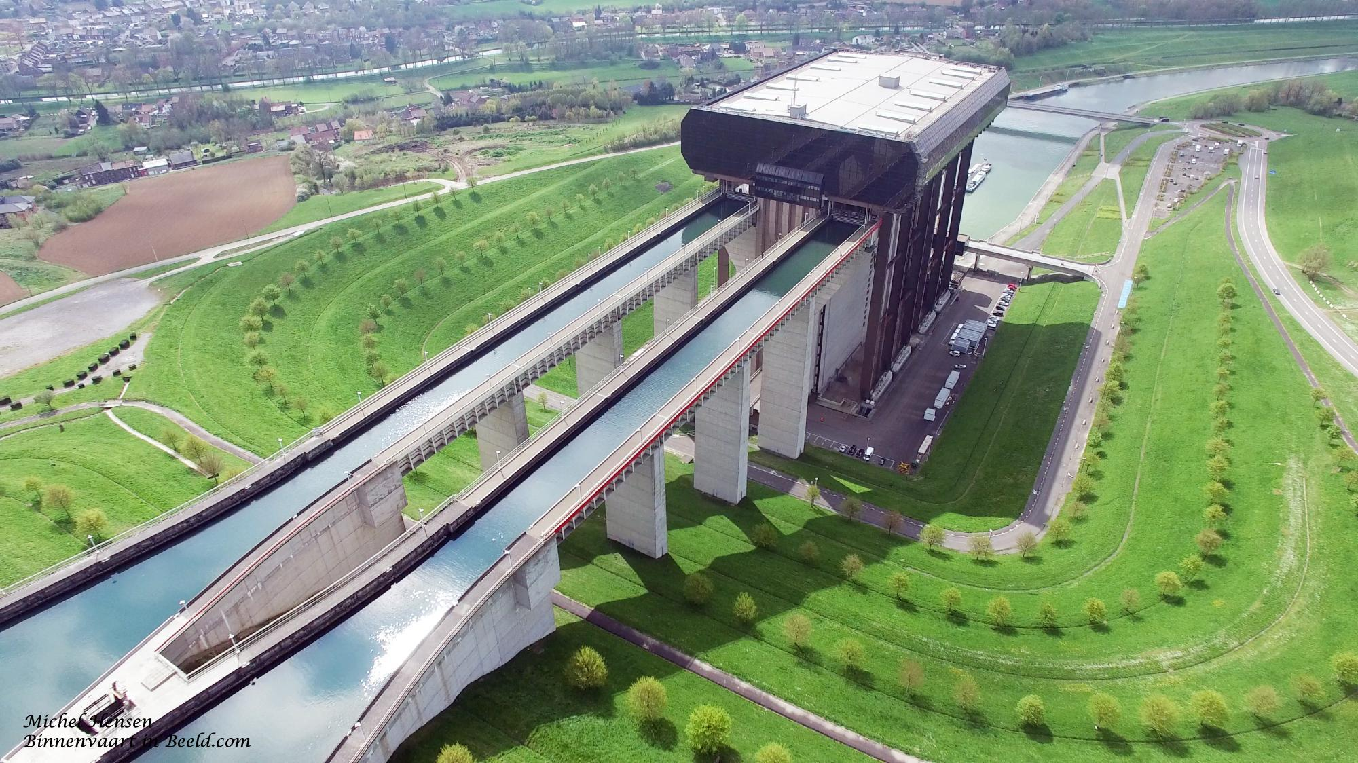
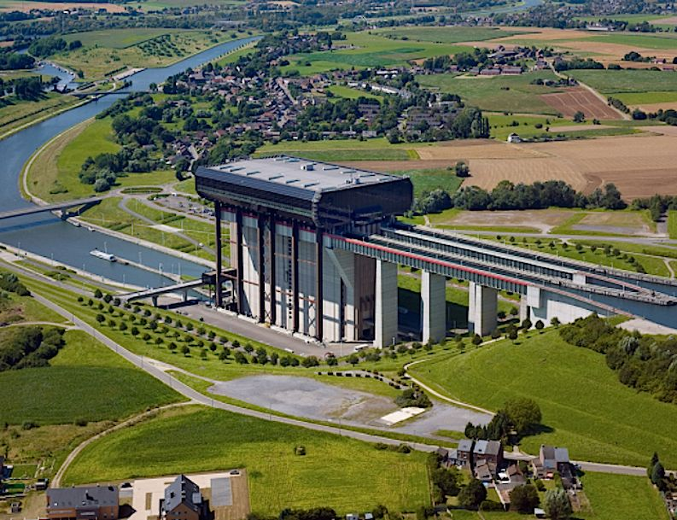
The Strépy-Thieu boat lift
(French: L'ascenseur funiculaire de Strépy-Thieu) lies on a branch of the Canal du Centre in the municipality of Le Rœulx, Hainaut, Belgium.
In 1957 the canal needed to be enlarged so that boats with a deplacement of 1350 tons would be able to pass.
At a certain point it was decided to alter the course of the canal rather than to enlarge it and a parallel canal was built. In the nineties a new boat lift was invented. It would replace the 4 lifts and 2 locks on the former canal.
With a height difference of 73.15 metres between the upstream and downstream reaches, it was the tallest boat lift in the world upon its completion, and remained so until the Three Gorges Dam ship lift in China was completed in January 2016.

Slide 7
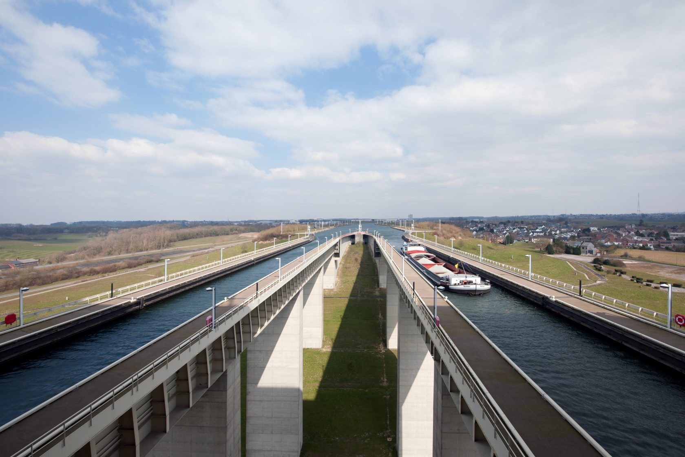
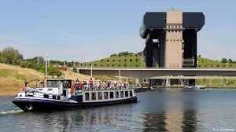
The structure consists of two independent counterweight caissons which travel vertically between the upstream and downstream sections. Because of the Archimedes principle, the caissons weigh the same whether they are laden with a boat or simply contain water.
Unfortunately, by the time it was finished in 2002 there was no more coal and steel industry in the Borinage and not as many ships sailing by as foreseen.
So for a long time it was considered as one of the public works that cost a fortune (647 mil. Euro) tax payers money with hardly a contribution to the country. Over the years many tourists were visiting the boat lift and pleasure boats started to make cruises on the canal.
And now with the inland navigation transport growing again, it finally starts to be really useful.
https://www.youtube.com/watch?v=wySQJ9hJQv8
https://www.google.com/maps?f=d&dirflg=d&saddr=&daddr=Rue%20Raymond%20Cordier%2050,7070,Thieu,BE
visitwallonia.be

Slide 8
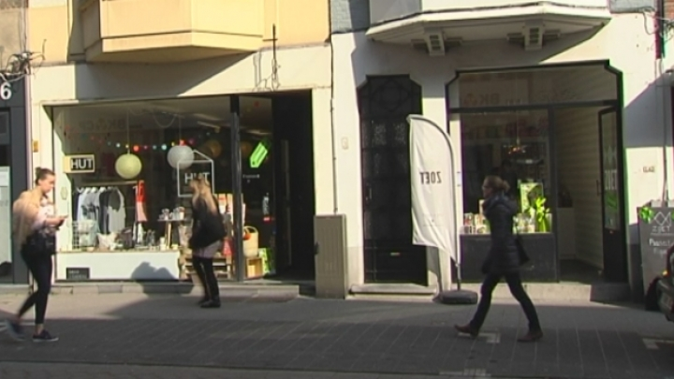
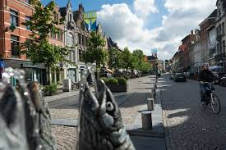
Mechelen is a very nice provincial city, situated between Brussels and Antwerp. It is just a 20 minutes train journey from both cities. Mechelen has a long history. It once was the capital of the Burgundian Netherlands but it is also a modern city with many young and educated habitants.
Over the past 20 years, a lot of renovation and restauration has been done and the results are fantastic. Mechelen became a really pleasant place to be. The city center is stunningly beautiful. A lot of streets are pedestrian area. Many young families are moving to Mechelen. More and more tourists are visiting the city. There is a very pleasant and positive atmosphere and it is a very safe city.
Tradition and innovation go side by side in Mechelen. A lot of new shops are opening, coffee shops are popping up everywhere, a lot of them serving healthy food
OLV straat
Ij zerenleen en OLV straat

Slide 9
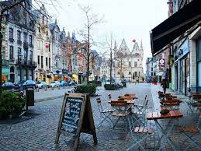
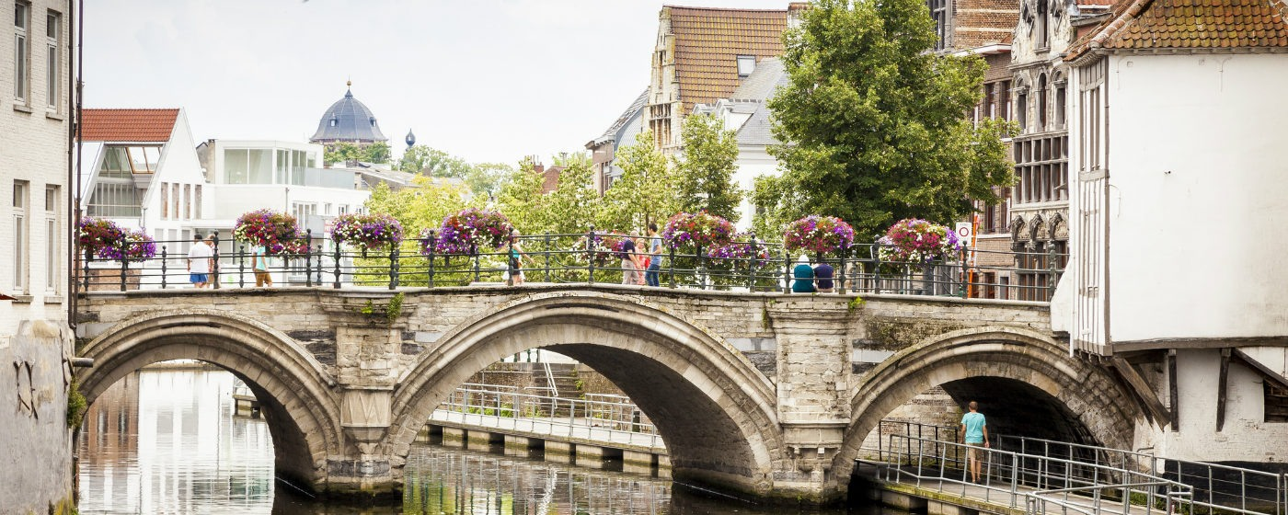
In the Onze-Lieve-Vrouwestraat you will find young designers, a lot of shops with sustainable and ecological goods, special bookshops, lifstyleshops . Also a very nice family business ‘ Verlinden’, where you will find everything for the bed, including fancy pyjama’s.
On the Korenmarkt, the Vismarkt and the Ijzerenleen you will find a lot of restaurants, more design stores and some old traditional high quality family businesses like a cheese shop (Schockaert), poultry shop (Maturin), Huis Windels (liquor and tobacco)
Korenmarkt
Grootbrug

Slide 10
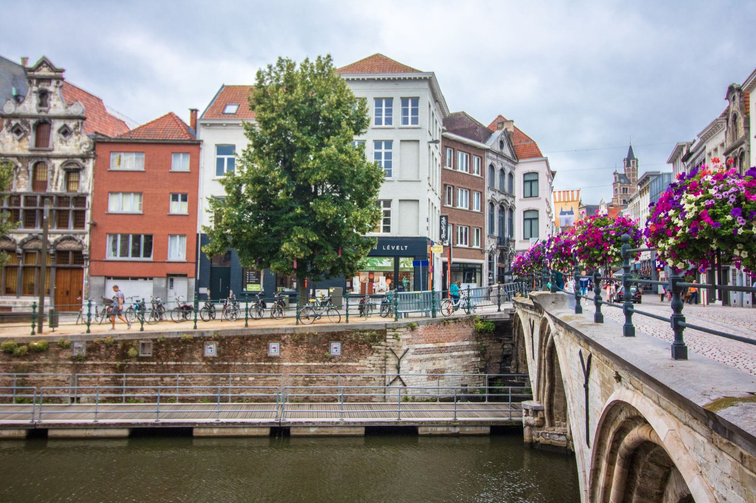
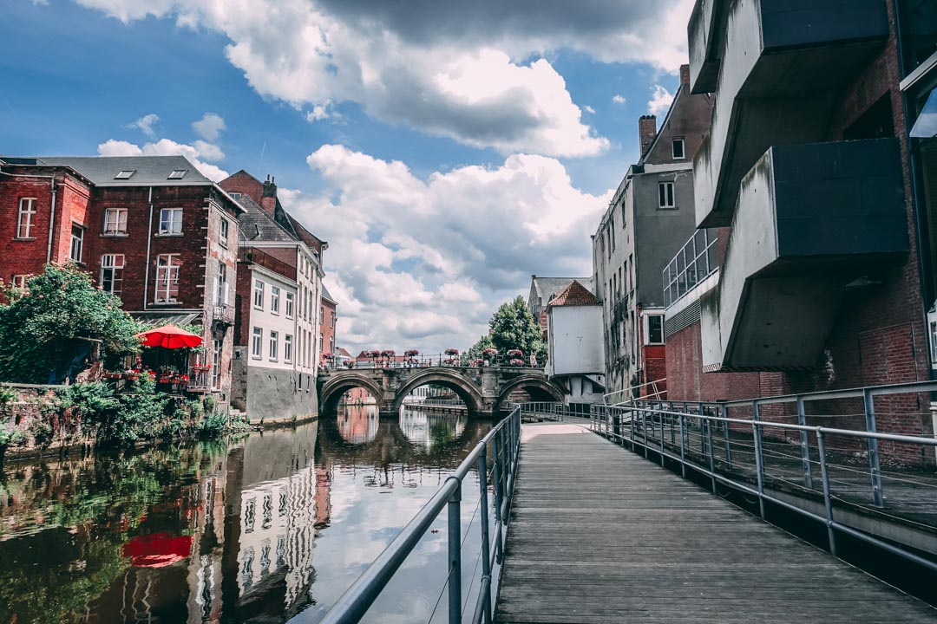
You can walk along the Dijle on the Dyle path to the Kruidtuin and along the Bruul, by the Beiaardschool to the Grote Markt.
Dijlepad Mechelen
Dijlepad Mechelen

Slide 11
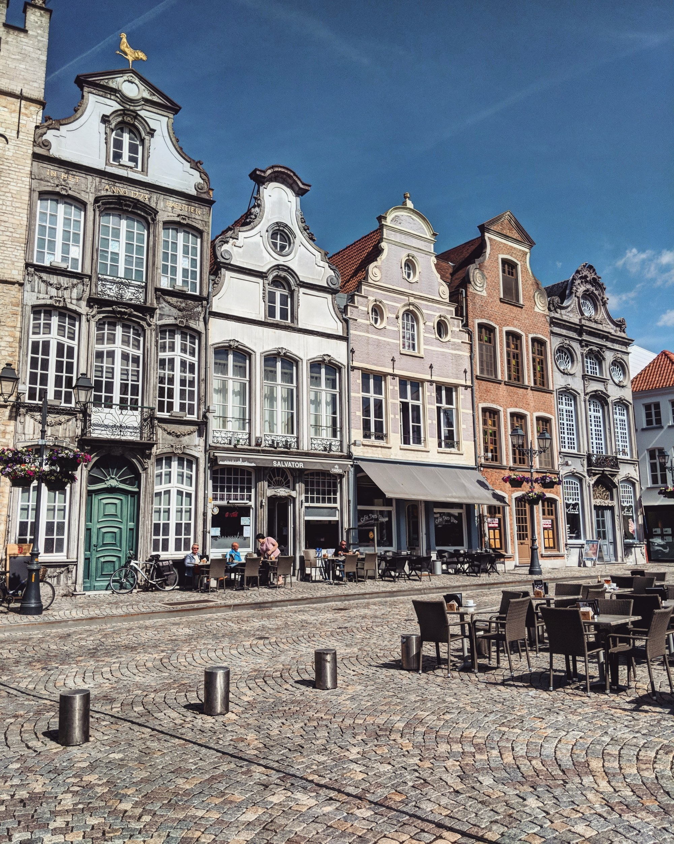
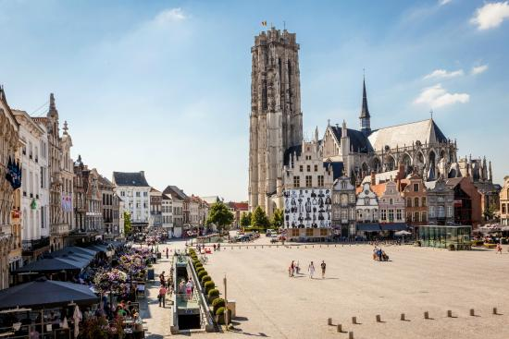
The Grote Markt is very beautiful, like a perfect postcard.

Slide 12
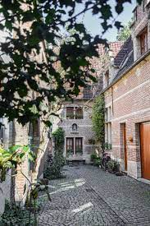
You can visit the Sint Rombouts cathedral with some of its incredible art or climb the (15th century) tower for a magnificent view over the city. It takes 20 minutes, 538 steps up and as many down…
You can visit the Saint-Johns church and see the Rubens painting ‘adoration of the Magi’. Mechelen counts 8 historical churches.
There is the Beguinage, big and small. Not as big as in other cities but a cosy little village inside the city with its own Begijnhofkerk.
Groot begijnhof

Slide 13
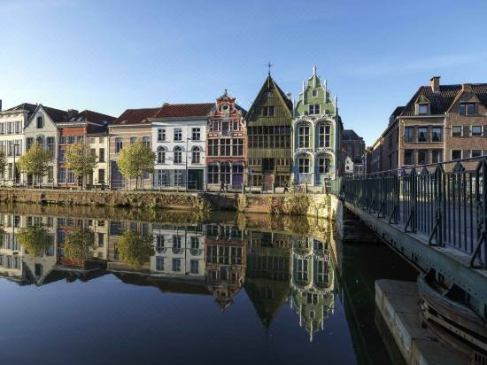
The Kazerne Dossin remembers the of 26.000 Jews, Roma and Sinti that were deported to Auschwitz during World War 2. It’s not only dealing with the Belgian story but it’s also a modern museum about massive violence.
Students from all over the world come to Mechelen to play church bells at the carillon school. It’s also the home of one of the last remaining places in the world that restores and repairs antique tapestries at Royal Manufacturers De Wit.
Haven Mechelen

Slide 14
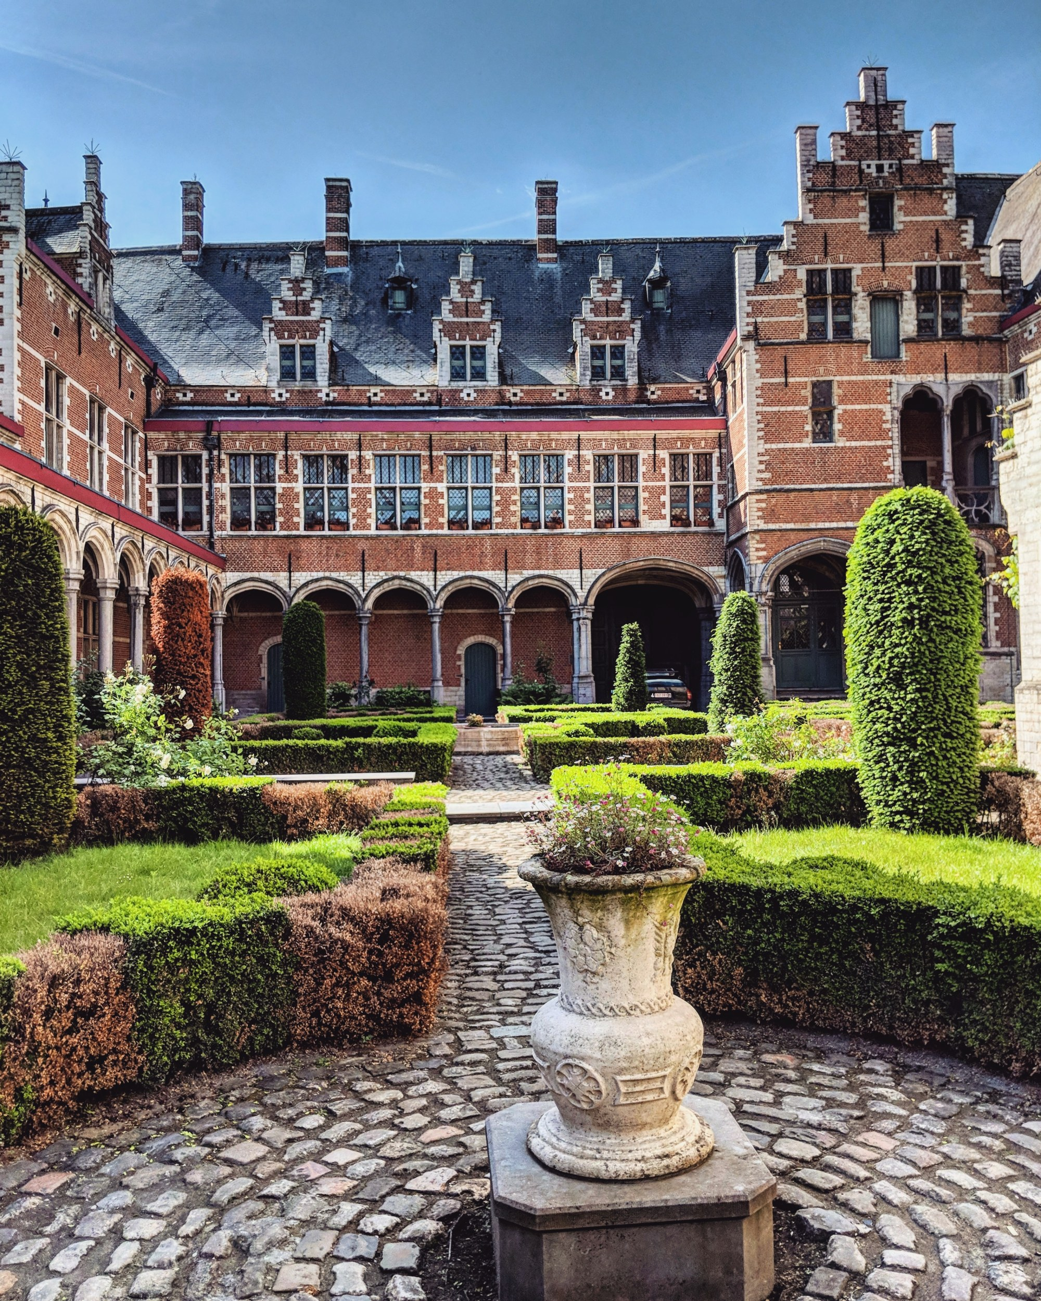
And last but not least: the beer. Brewery Het Anker (1369) is one of Belgium’s oldest brewery’s.
Gouden Carolus is the famous beer that is brewed there. You can visit the brewery or have a beer or an excellent meal in the Brasserie. Or go and have a drink in Mechelen’s oldest bar D’Hanekeef where they serve over 50 different beers.
On Saturday morning there is a market in the center. If you park on the Douaneplein, just outside the ring,a free shuttle brings you to the center (only on Saturdays)
If you want to stay overnight, Martin’s Patershof is a 4 star hotel in a former church.
visitmechelen.be - Contact Information center: Vleeshouwerstraat 6, 2800 Mechelen
Binnenhof

